Slide 1
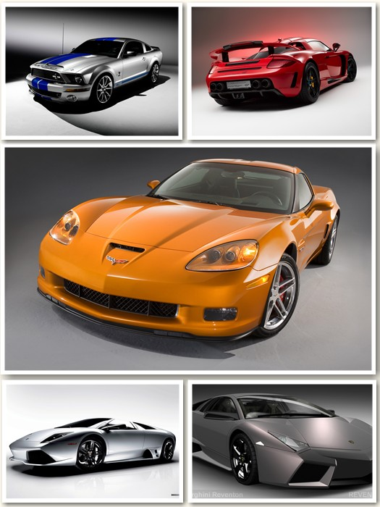
Analyzing and Predicting Car Prices in the Australian Market
CSIS 3360
Carlos Sibaja
John Zapana
Esta foto de Autor desconocido está bajo licencia CC BY-SA-NC

Slide 2
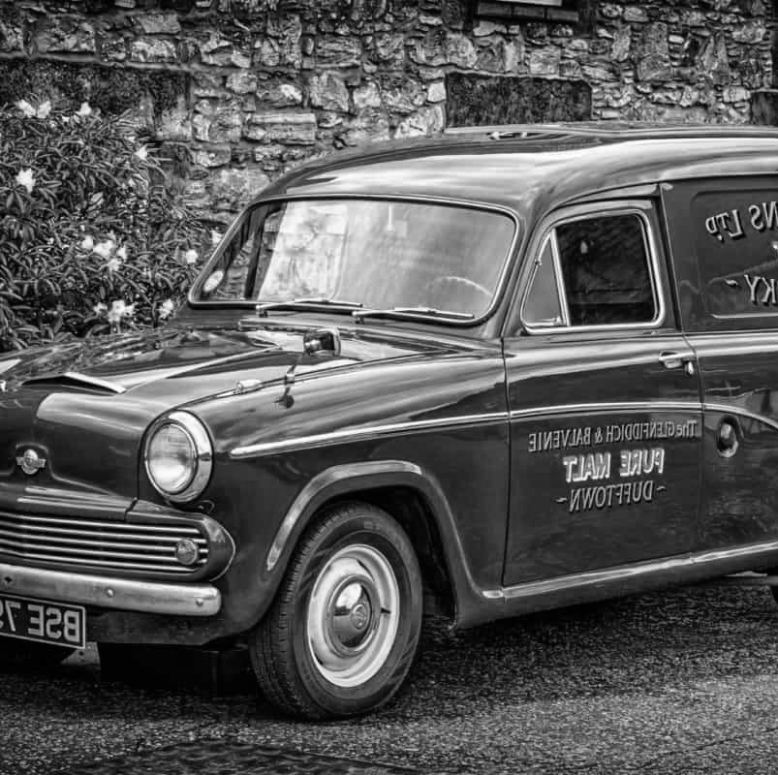
TABLE OF CONTENT
METER LA TABLA
APPENDIXES

Slide 3
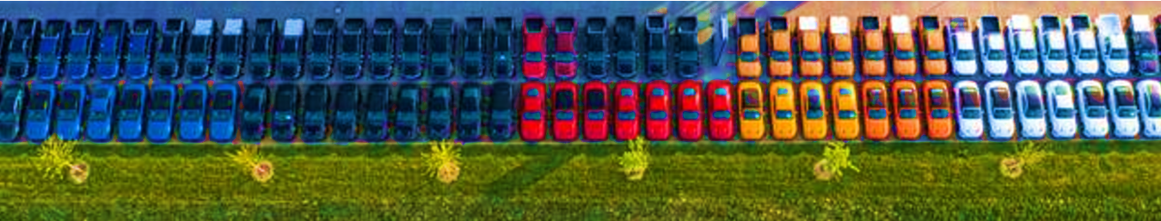
PROJECT GOALS AND OBJECTIVES
Analyze the Australian Car Market dataset to explore insights and build predictive models. The goal is to identify factors influencing car pricing, discover trends and groupings, and recommend the best model for predicting car prices.

Slide 4

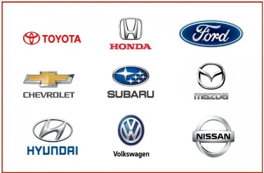
DATA SET
SOURCE
https://www.kaggle.com/datasets/lainguyn123/australia-car-market-data
There are new and used cars, from the years 1989 to 2022, and there are several brands and types.

Slide 5
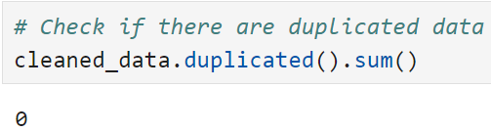
DATA SET
This dataset provides information about the car market in Australia
16 columns,
No missing values,
No duplicated values,
10 categorial variables,
6 (5) numerical variables,
Car name, include the year and brand,
ID is not
Number | Variable Name | Description | Observations | Nulls | Type of Variable
1 | ID | Car Code | 17048 | non-null | int64
2 | Name | Car Name | 17048 | non-null | object
3 | Price | Car Price | 17048 | non-null | int64
4 | Brand | Car Brand | 17048 | non-null | object
5 | Model | Car Model Year | 17048 | non-null | object
6 | Variant | Car Variant | 17048 | non-null | object
7 | Series | Car Series | 17048 | non-null | object
8 | Year | Year of Manufacture | 17048 | non-null | int64
9 | Gearbox | Gearbox Type | 17048 | non-null | int64
10 | Type | Body Design or Car body | 17048 | non-null | object
11 | Fuel | Fuel Type | 17048 | non-null | object
12 | Status | Car Condition | 17048 | non-null | object
13 | Kilometers | Mileage | 17048 | non-null | object
14 | CC | Engine Capacity | 17048 | non-null | int64
15 | Color | Car Color | 17048 | non-null | object
16 | Seating Capacity | Seating Capacity | 17048 | non-null | int64

Slide 6
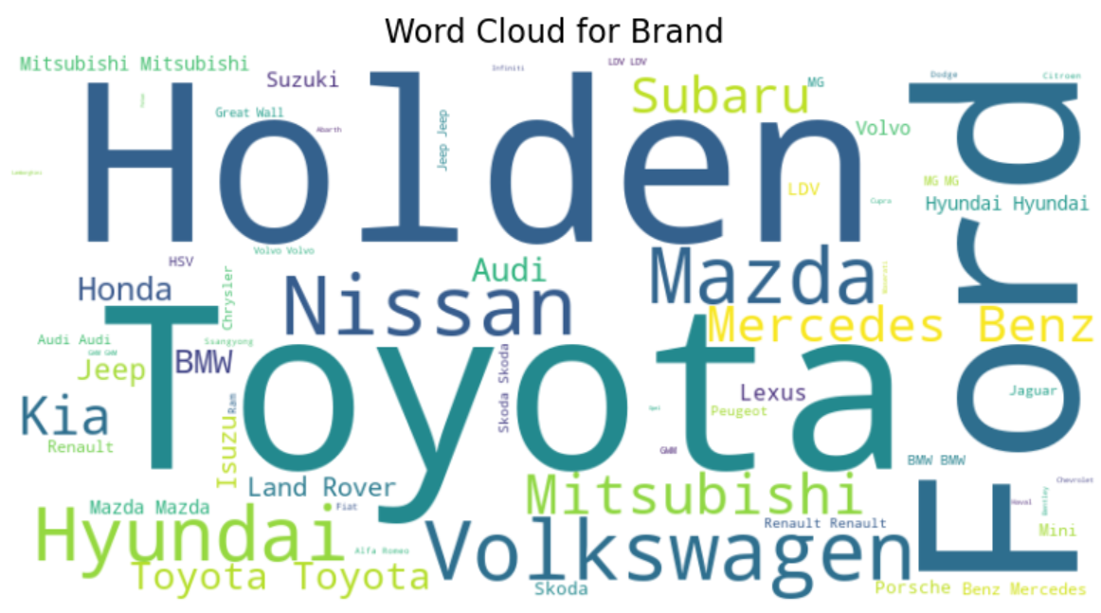

DATA EXPLORATION
Holden is an Australian automaker, established in 1856
58 Brands! in total

Slide 7
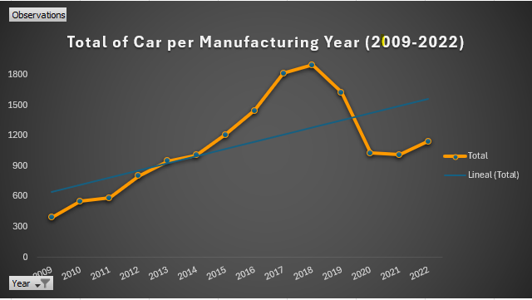
DATA EXPLORATION

Slide 8
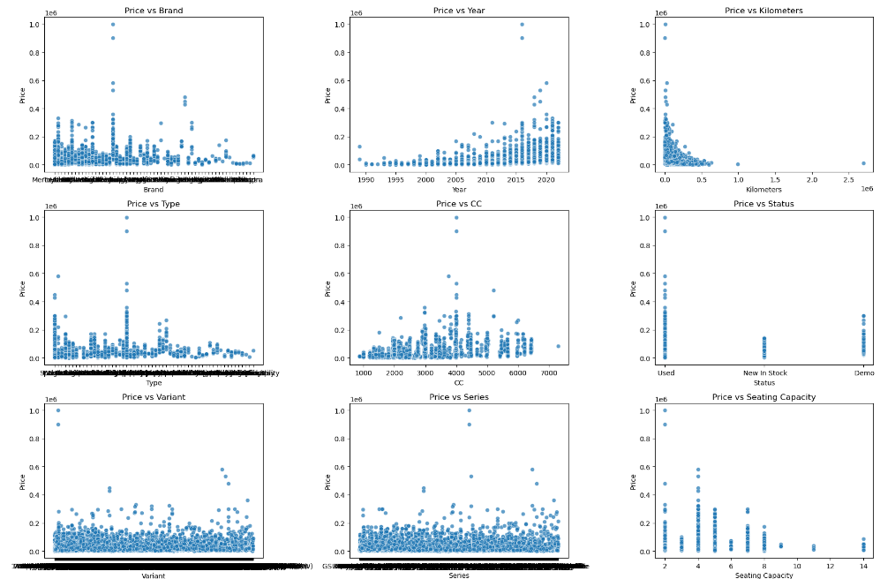
DATA EXPLORATION

Slide 9

Preprocessing
Data Cleaning
Check for spaces from all object (string) columns.
Check for duplicate records and remove them if necessary.
Drop irrelevant columns (e.g., ID, Name, Model, Variant, etc).
Rename columns for better clarity.
Handling incorrect or redundant values (e.g., Brand, Type, Gearbox, Fuel, etc).

Slide 10
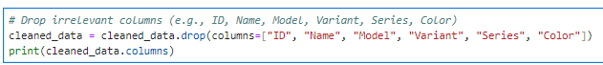
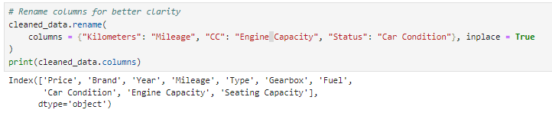

Preprocessing
Example of the Data Cleaning Performed

Slide 11
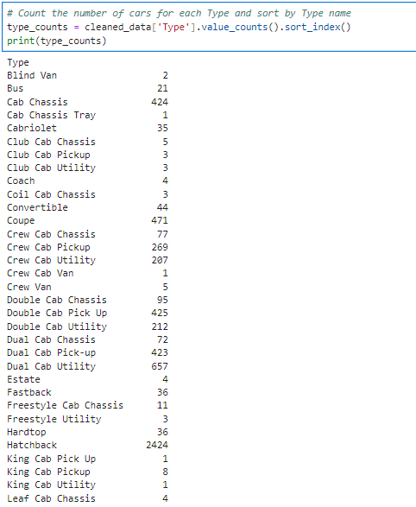
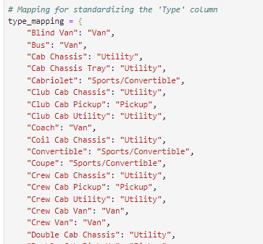
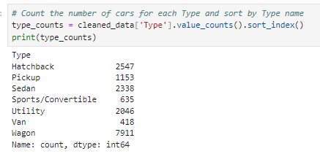
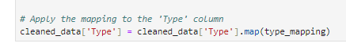

Slide 12

Data Processing
Boxplots to identify outliers in Price, Mileage and Engine Capacity.
Remove or cap outliers (e.g., extremely high or low prices or mileage).
A heatmap of correlations to explore relationships between numerical variables like Year, Mileage, Engine Capacity, Seating Capacity, and Price.
Scatterplots (e.g., Year vs. Price, Mileage vs. Price, Engine Capacity vs. Price, Seating Capacity vs. Price) to visualize trends.
Esta foto de Autor desconocido está bajo licencia CC BY-NC-ND

Slide 13
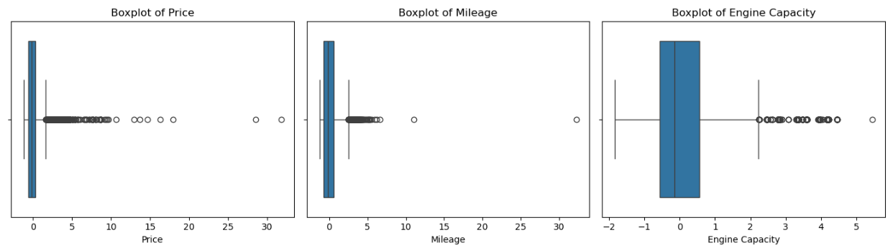
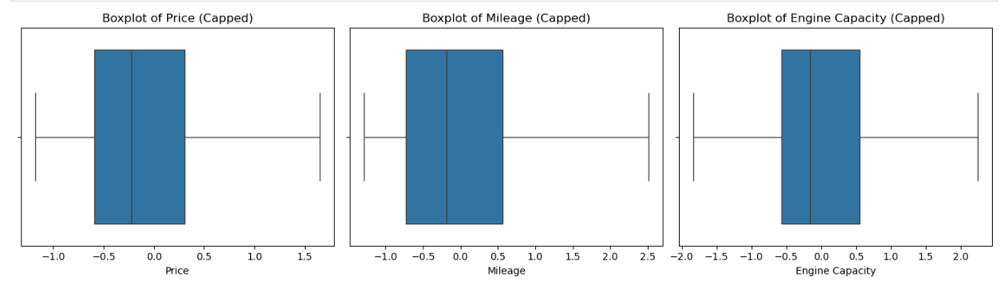
Notes:
Scale numerical features (e.g., Price, Mileage, Engine Capacity, Seating Capacity) using StandardScaler for Visualizations and Models.

Slide 14
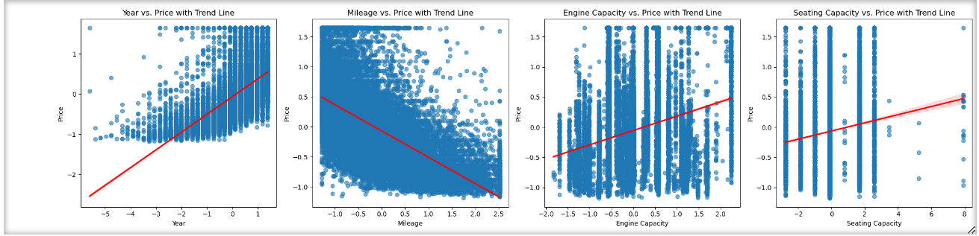
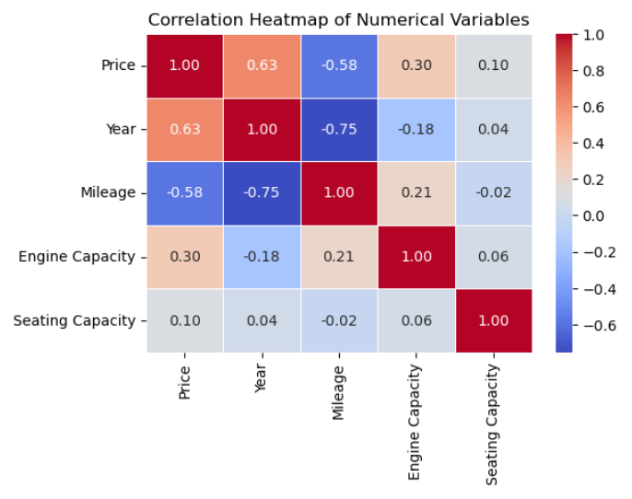

Slide 15
PREDICTIVE MODELS
Objective:
Predict car prices based on features.
Features for Clustering:
Select relevant features: Price, Year, Mileage, Engine Capacity, Seating Capacity, Type, Gearbox, Fuel, Car Condition.
Convert categorical variables (e.g., Fuel, Car Condition) into dummy/encoded variables.
LINEAR REGRESSION
XG BOOST
RANDOM FOREST
Notes:
Random forest is a machine learning technique that builds on the simplicity of decision trees and improves their predictive performance by combining the results of several trees to form a "forest". It works by constructing numerous decision trees at training time and outputs the mode of the classes (for classification tasks) or the mean prediction (for regression tasks) of the individual trees.

Slide 16
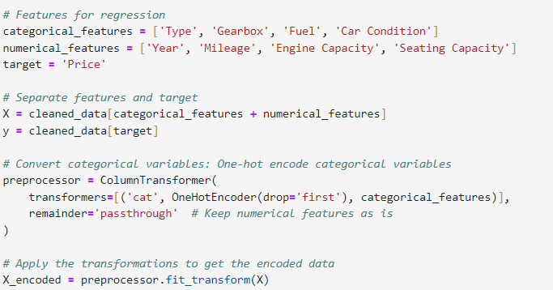
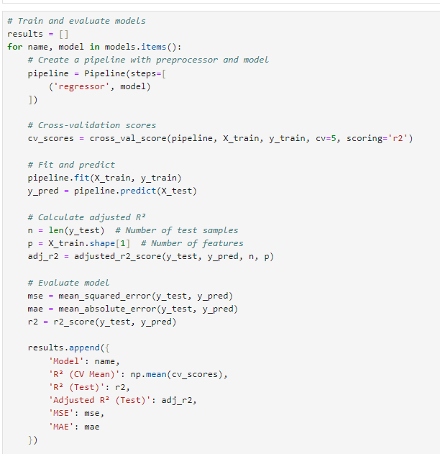

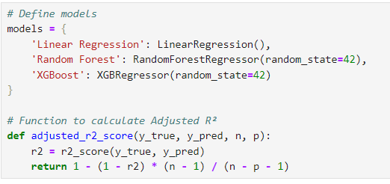
LINEAR REGRESSION
Extract of the Code in Phython.
MODEL

Slide 17
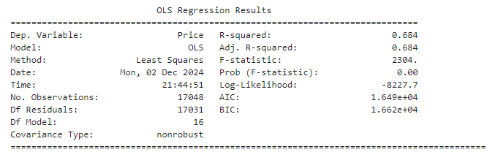
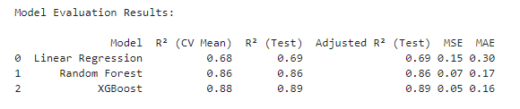
LINEAR REGRESSION
Results
Notes:
XGBoost stands for eXtreme Gradient Boosting. It is a highly efficient and scalable implementation of gradient boosting, a machine-learning technique used for regression.
The main advantage of XGBoost over Linear Regression lies in its ability to handle non-linear relationships between features and the target variable

Slide 18
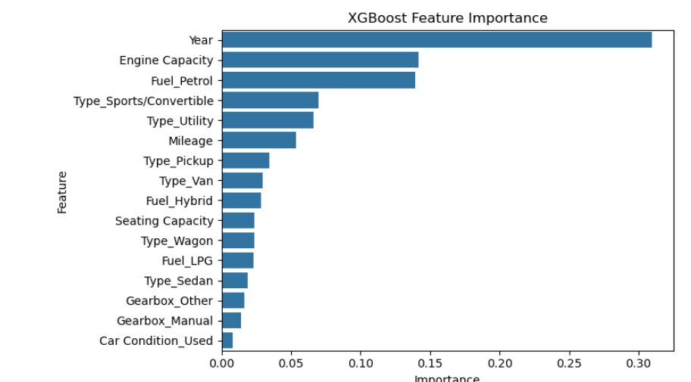
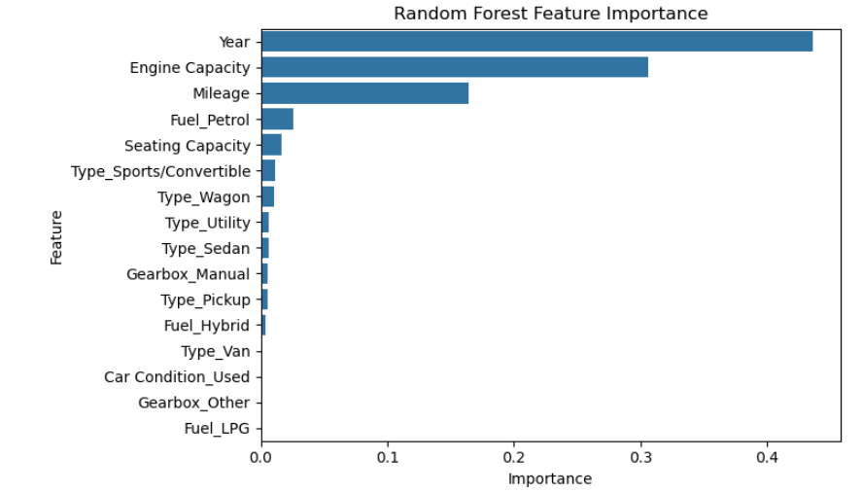
Features have the most significant impact on car prices.

Slide 19
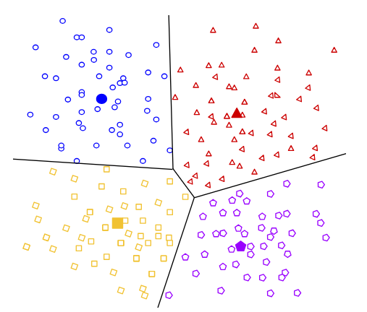
CLASSIFICATION MODEL USED
CLUSTERING
CLUSTERING
Determine the optimal number of clusters (k) using the Elbow Method.
Use K-Means Clustering.

Slide 20
CLASSIFICATION MODEL
Objective::
Group cars based on similar attributes to identify distinct segments.
Features for Clustering:
Select relevant features: Mileage, Car Condition, Year, Price, and Fuel.
These features will be used to form the clusters, and K-Means will try to group cars that have similar values in these features.
Convert categorical variables (e.g., Fuel, Car Condition) into dummy/encoded variables.
CLUSTERING
Notes:
Clustering is a technique used in unsupervised machine learning that involves grouping a set of objects in such a way that objects in the same group (called a cluster) are more similar (in some sense) to each other than to those in other groups

Slide 21
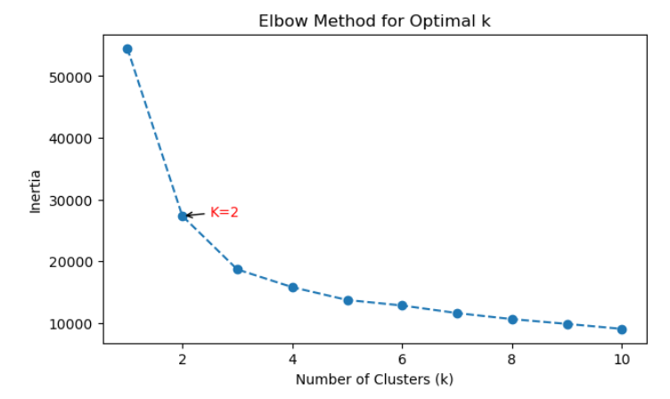
CLUSTERING
CLUSTERING

Slide 22
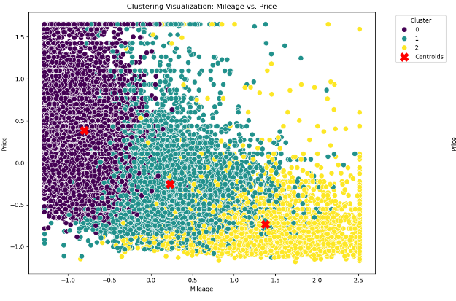
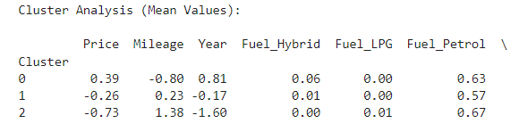
CLUSTERING
CLUSTERING

Slide 23
Insight John lo mas importante.
How do clusters align with pricing and features?
Cluster 0 (Higher Price):
Price: Higher than average (mean price = 0.61).
Mileage: Lower than average, indicating less wear and tear (-0.86).
Year: Recent cars (0.89), implying newer models.
Fuel: Significant proportion of petrol cars (55%) and some hybrid vehicles (7%).
Condition: Mostly used cars (87%).
Cluster 1 (Lower Price):
Price: Lowest among all clusters (-0.72).
Mileage: High, indicating older or heavily used cars (1.24).
Year: Much older models (-1.42).
Fuel: Predominantly petrol cars (67%), with minimal LPG presence.
Condition: All cars in this cluster are used (100%).
Cluster 2 (Mid Price):
Price: Around the average (-0.26).
Mileage: Near-average mileage (0.01), likely representing balanced usage.
Year: Moderately old cars (0.02).
Fuel: Predominantly petrol cars (63%), with a small fraction of hybrids.
Condition: Entirely used cars (100%).
What actionable insights can dealerships derive from these segments?
Cluster 0 (Higher Price):
Represents premium cars, and very new with low mileage.
Cluster 1 (Lower Price):
Represents budget cars, mostly used, regardless of age or mileage.
Cluster 2 (Mid Price):
Represents mid-range cars with balanced options (reasonable pricing, average mileage, moderately old).

Slide 24
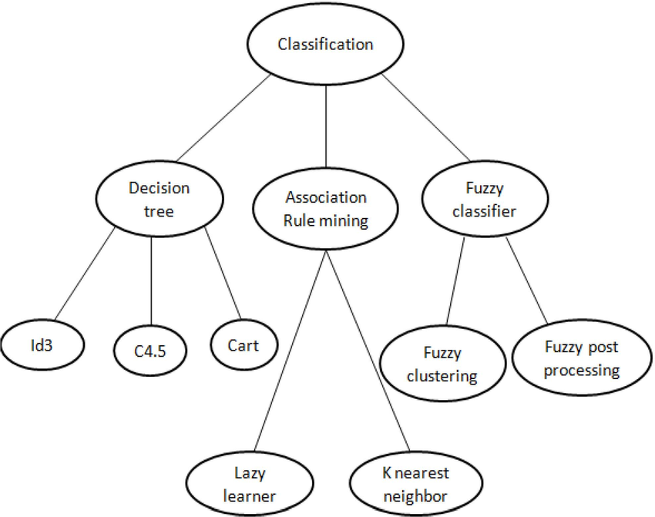
CLASSIFICATION MODEL
Classification
CLUSTERING
Decision Trees
Random Forest
Naïve Bayes
Classify cars into price ranges
(e.g., low, medium, high).

Slide 25
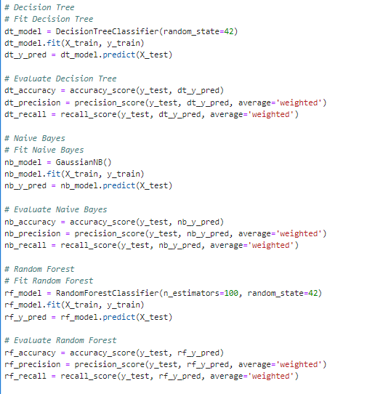
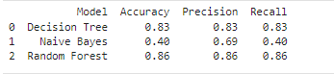
Conclusion: The Decision Random Forest is performing much better across all metrics than the Other models. It has a much higher accuracy, precision, and recall, making it the better choice for this classification task.

Slide 26
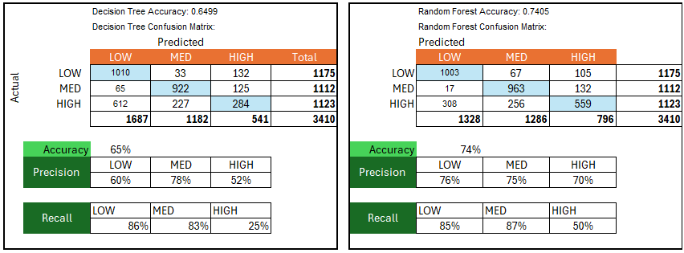
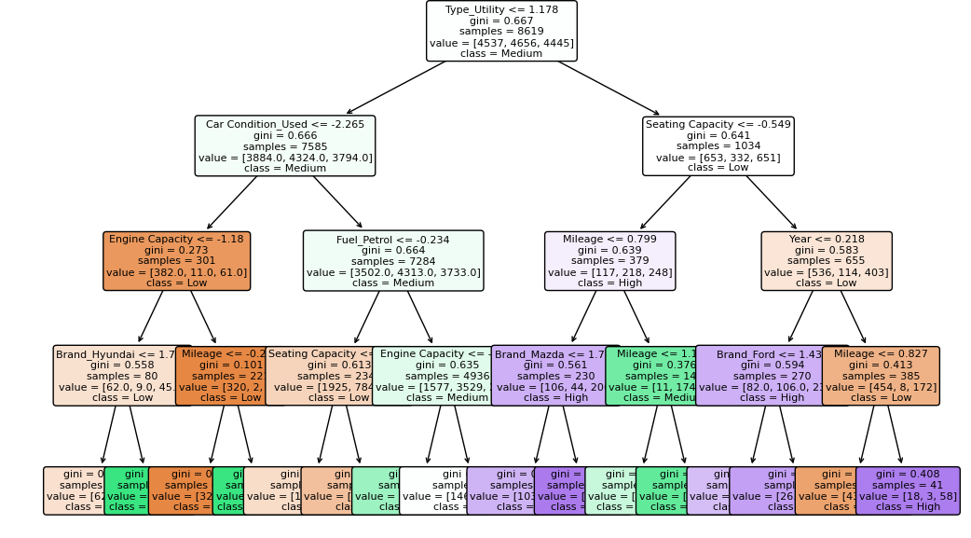
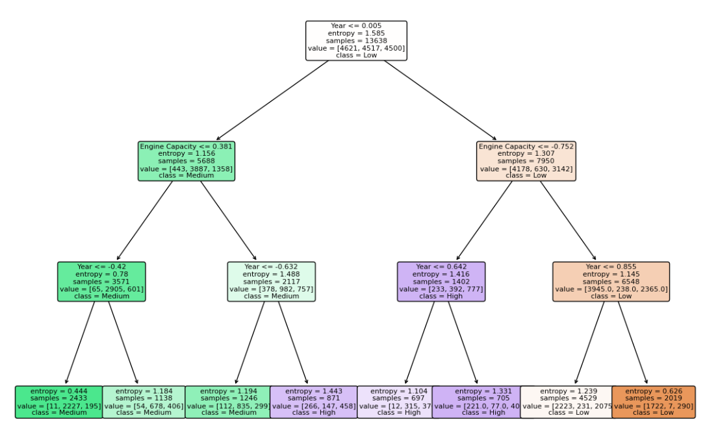

Slide 27

Learnings and Challenges
You don’t know if a model is good or not until you try it. We dropped two datasets.
Some models are complicated to do in Excel.
You need to run the model several times to do fine-tuning.
CSV files are not XLMs; save it in the correct way to avoid losing the work.
Python is an excellent tool for data science.
- Tools: Excel, Anaconda, Jupyter Notebook, PPT
Esta foto de Autor desconocido está bajo licencia CC BY-NC-ND

